Slide 1
1.6 Electron arrangement

Slide 2
Energy levels
Electrons are found in specific energy levels ( energy shells) around the nucleus of the atom. Electrons in the same energy levels have the same amount of energy.
The higher energy level an electron occupies, the more energy the electron has. Every electron in an atom has to be in an energy level, cannot exist between levels, they can move between the levels by absorbing or releasing energy.

Slide 3
The general formula 2n² can be used to determine the maximum number of electrons an energy level can hold, where ‘n’ is the energy level number.

Slide 4
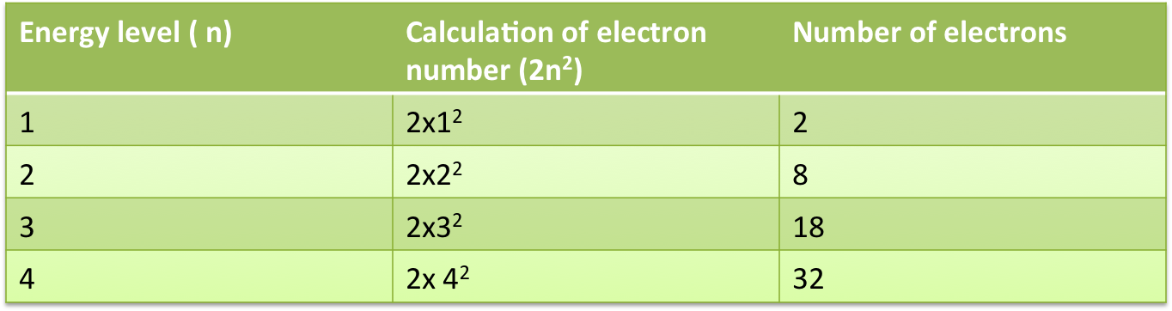
Maximum number of _x0005_electrons in each Energy level
Energy levels correspond to the horizontal periods in the periodic table. Period 1
contains the elements hydrogen and helium; so this period has two elements and two
electrons in that shell. Period 2 contains eight elements and eight electrons in that
shell. After this periodic table gets a little more complicated and the patterns are not
as easy to identify.

Slide 5
Energy levels (or shells)
They are denoted by the numbers 1,2,3,4,…
These numbers are called principal quantum numbers (n)
Simple electron configurations just shows the number of electrons in each energy level.
e.g. potassium 2,8,8,1
chlorine 2,8,7

Slide 6
Electron configuration
Electrons are arranged in specific ways that are unique to each atom. Electrons around a nucleus fill up in order and occupy the lowest energy levels first.
Configurations are written to show how many electrons are in each level, and the order of levels.
See examples in Table: C1.4 Page: 115

Slide 7
Elements in the first row of transition metals have 21- 30 electrons. The last electrons of transition metal elements go into the third not fourth energy level. This is most stable arrangement of electrons.
E.g. Scandium: number of electrons- 21, electron configuration- 2,8,9,2
Titanium: number of electrons- 22, electron configuration- 2,8,10,2
Zinc: number of electrons- 30, electron configuration- 2,8,18,2
So, third energy level is full, in the elements gallium and germanium, the electrons start to fill up the fourth energy level.
Gallium: number of electrons- 31, electron configuration- 2,8,18,3

Slide 8
Subshells
Each major energy level contains one or more subshells, designated as s, p, d and f. Each subshell contains regions of physical space called atomic orbitals, inside which electrons move.
Each atomic orbital cannot contain more than two electrons and if it does contain two electrons, they spin in opposite directions.

Slide 9
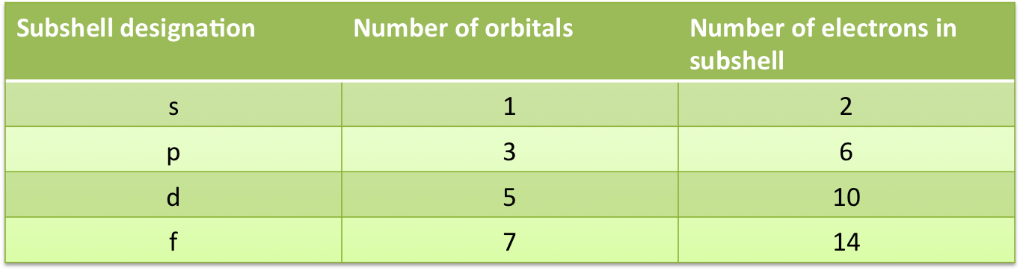
The first energy level has only one subshell, and it is given the designation 1s.
The second energy level has two subshells, s and p
The third energy level has 3s, 3p and 3d subshells
The fourth energy level has 4s, 4p, 4dand 4f subshells.
The number in front represents the main energy level, and the letter represents a
particular subshell

Slide 10
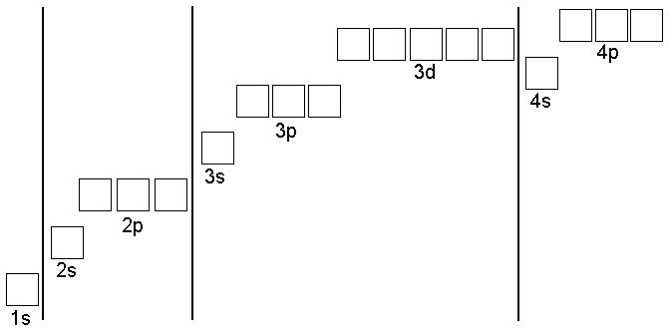
Orbitals in each subshell

Slide 11
The electron configurations of the elements
To determine the electron configuration of an atom in its lowest energy or ground state:
Place the electrons into orbitals starting with the lowest energy orbitals first.
Place a maximum of 2 electrons into each orbital

Slide 12
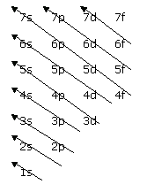
Order of filling energy sublevels
Increasing energy

Slide 13
s- subshell always has the lowest energy, followed by p subshell, then the d and f subshells.
Groups 1 and 2 are s - block, groups 13-18 are p-block, the transition metals are the d- block elements and the lanthanides and actinides are the f-block.
See periodic table in next slide.

Slide 14
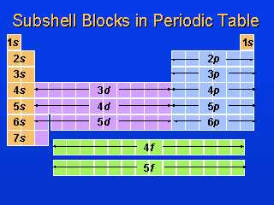
Subshells related to position in the periodic table

Slide 15
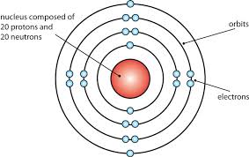
Representing electrons
A simple shell diagram shows the arrangement of electrons in their energy levels. This can be represented by showing each electron individually, or by using the numbers of electrons in each shell.

Slide 16
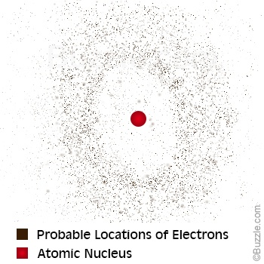
Electron charge cloud diagrams
Electrons around a nucleus exist in regions of space. It is impossible to identify exactly where an electron is located in an atom, only the region of space in which it is likely to be.
Do Question set: 1.4 Q’s: 1,2 3, 4 (a) , 5 (b) 6 (a)

Slide 17
Do Question set 1.4 Q’s: 1,2,3 4 (a), 5(a), 6(b)

